Slide 1
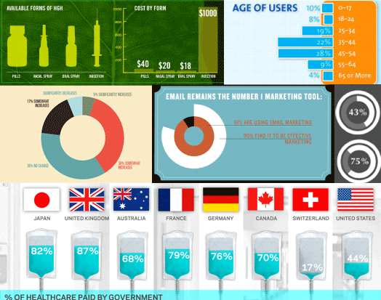
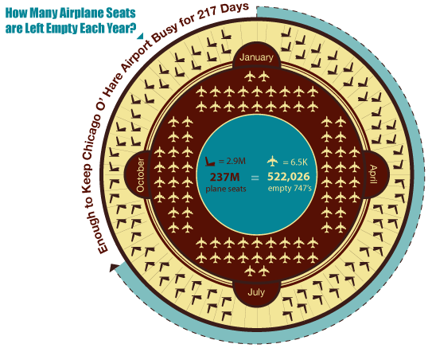
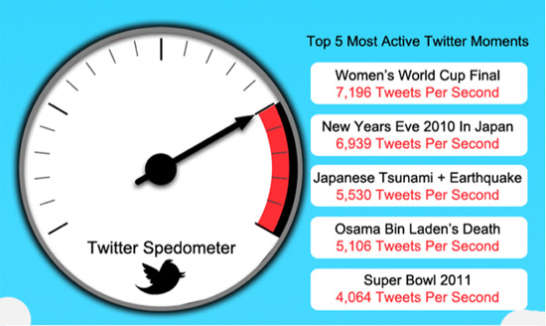
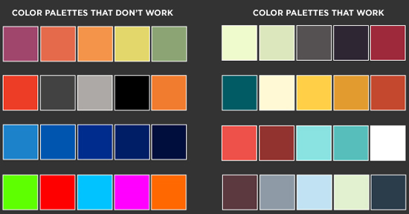
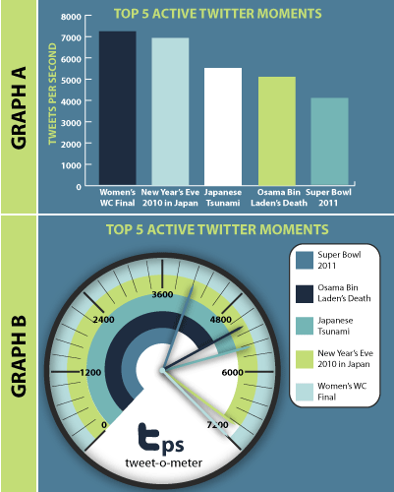
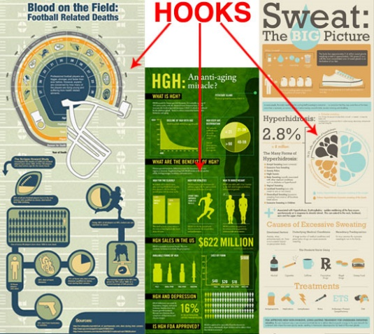
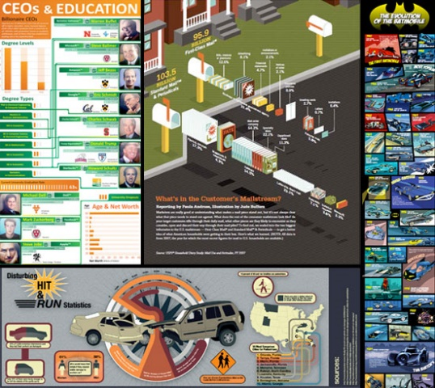
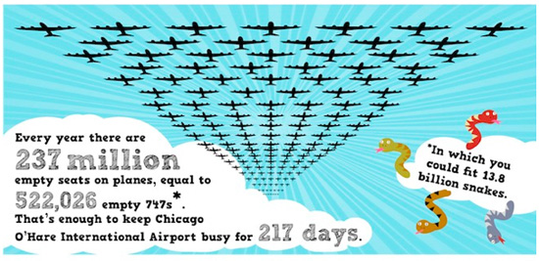
The Do’s and Don’ts of Infographic Design
by Amy Balliett - Smashing Magazine - 10/14/11

Slide 2
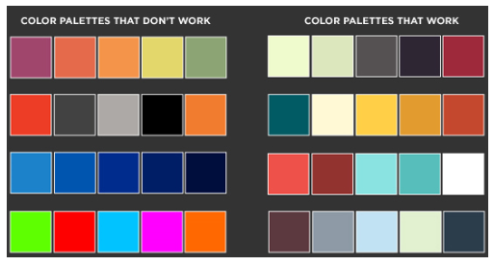
KEY POINTS FROM The Do’s and Don’ts of Infographic Design by Amy Balliett - Smashing Magazine - 10/14/11
The term “data viz” comes from “data visualization,” which implies that sets of data will be displayed in a unique way that can be seen, rather than read.
Today, infographics compile many different data visualizations into one cohesive piece of “eye candy.”
Show, don’t tell – display information visually and dress up conventional graphs and charts whenever possible
Think about interesting organization – will your information flow vertically? horizontally? be divided in sections? tell a story by having a beginning, middle, and end?
Use color – often using three colors that work together is easy for your audience’s eyes
Notice how the info about government healthcare is depicted using an IV bag, which is a medical tool of healthcare. The idea of government is depicted by the national flags.

Slide 3
TASKS:
Pick two colleges in which you are interested
Complete the graphic organizer to research/ obtain information (see teacher page)
Select 5 key elements by which to compare them in an infographic
Create infographic
Complete written component paragraph(s)
Submit

Slide 4
As you examine the samples of compare/contrast infographics, from which you can choose, click on the
button to view the entire infographic as a model.

Slide 5
Compare/
Contrast
Look at the differences/
similarities between two things
Notes:
Netflix link: http://www.dailyinfographic.com/netflix-vs-redbox
Bitcoin link: http://www.dailyinfographic.com/bitcoin-vs-gold-infographic

Slide 6
Compare/
Contrast
Look at the differences/
similarities between two things
Then scroll down a bit for the whole infographic!
Then scroll down a bit for the whole infographic!
Notes:
Netflix link: http://www.dailyinfographic.com/netflix-vs-redbox
Bitcoin link: http://www.dailyinfographic.com/bitcoin-vs-gold-infographic

Slide 7
WRITTEN COMPONENT (about ¾ to 1 page, double spaced)
This must by TYPED. Explain in full sentences and in paragraph form how the combination of visual elements (images, colors, background, lay out, font) and text in your infographic work to:
Put forth criteria elements crucial to college selection
Reveal your purpose in comparing/contrasting
Cater to your audience (other high school juniors)
THEN, explain why, after doing this infographic, which college you think might be a better fit for you. If you’re still not sure, what specifically do you want to pay attention to when you visit each campus?

Slide 8
VISUAL CONSIDERATIONS
As you start to design your infographic, give thought to the visual choices:
Background
Chart/pie graph/bar graph format
Images
Font
Color
Lay-out
Be creative and visually engaging!
See samples on the next few slides.

Slide 9
Clever! An infographic on people and their tablets is shaped like an iPad!
Note that the pie chart is placed within the “Uncle Sam” hat to reflect the focus on America’s budget issues.

Slide 10
The bookshelf background is logical and creative in portraying info about writing mistakes; separating info within books is also a relevant way to organize information.

Slide 11
The background design resembles a subway/metro system to hint at the idea of a vast network of companies/ services associated with Amazon.

Slide 12
In this excerpt of an infographic, the Lego background grabs attention, AND it is connected to the topic.

Slide 13
The visual incorporates effective overlays to demonstrate how Godzilla has been sized for films over the years. What would be even more interesting might be notes about how the size reflects social issues/concerns during the year of the movie’s release. For instance, look how big Godzilla is in 2014. Is that because audiences want impressive special effects? Is it because in a post 9-11, terrorized, diseased, financially struggling world people need a mega-hero (remember that in the most recent film, Godzilla saves the day)?

Slide 14
SUBMISSION REQUIREMENTS:
Submit your typed planning sheet.
Your infographic must be submitted in color. It can be one sheet of paper or extend into two 8 ½ x 11 sheets of paper---just tape the two parts together for continuity. If you don’t have a color printer, see me prior to the due date for a pass to the library to print in color. Make sure that your visual elements are clear/readable.
Also print your typed “written component.”
If you are absent the day that the work is due, you must email the infographic AND written component by 9 am and bring a printed copy of materials upon your return.
*See rubric on the next slide!

Slide 15
RUBRIC
Infographic ✓+ ✓ ✓ -
Visually appealing and clearly readable
Clear criteria compared/contrasted
Purposeful design choices
Written components ✓+ ✓ ✓ -
Planning chart is thorough
Clear, specific justifications for the way in which
the mix of visual and text aspects reveals purpose, catering
to audience (make detailed references to your own work)
Clear, specific explanation of whether the colleges are a good
fit and/or what you need to look for when you visit
Grammar/mechanics ✓+ ✓ ✓ -
Proofread for accuracy and style

